Slide 1
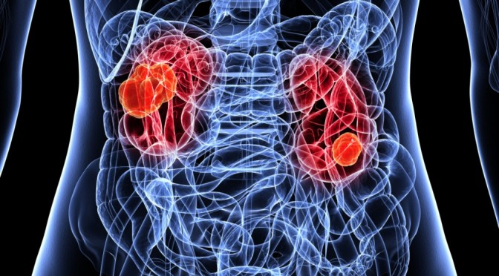
topic05 team02 Arne Weigelt Franca Klaeren Jessica Albrecht kidney cancer
project proposal
"Dieses Foto" von Unbekannter Autor ist lizenziert gemäß CC BY

Slide 2
Drug repurposing
benefits
Lower risk for failure
Development takes less time
Less investment
Approaches
Computational
experimental

Slide 3
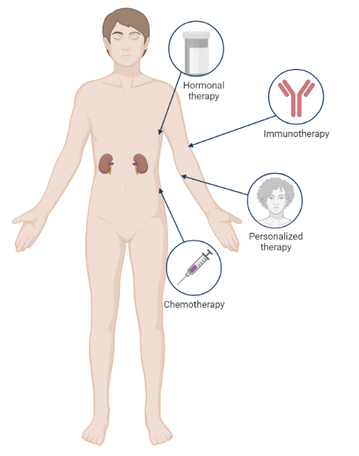
Research question
Identification
of kidney cancer drugs
BioRender.com
Notes:
drug repurposing?
General benefits

Slide 4
Datasets

Slide 5
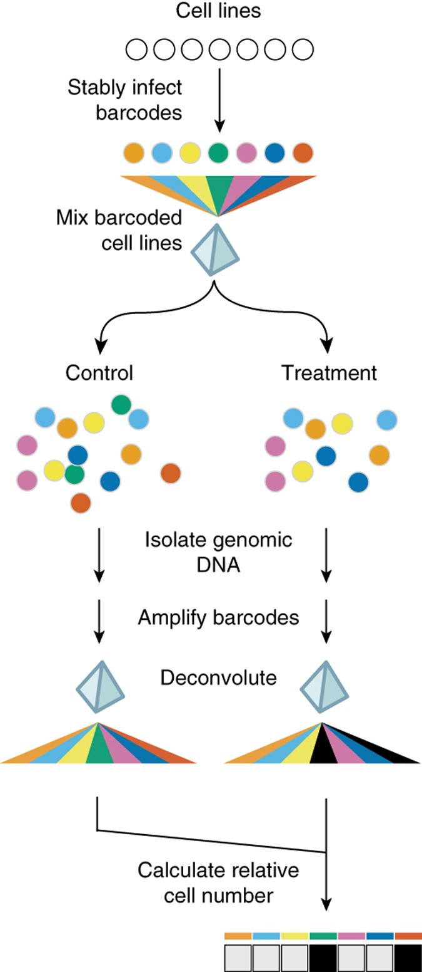
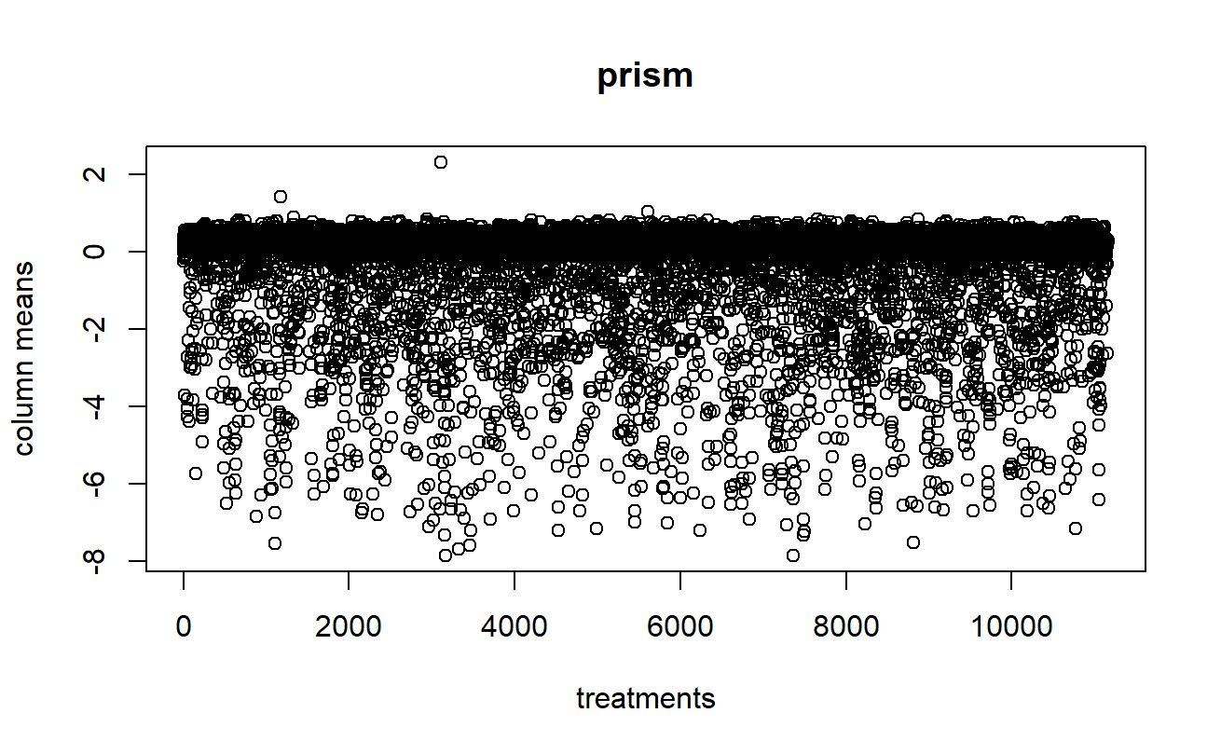
prism
 | treatment
Cell lines | Effect of treatment on cell growth
Notes:
A
24-base-pair DNA barcodes encoded within lentiviruses are stably integrated into individual tumor cell lines after blasticidin selection,
barcoded cell lines are individually frozen and later thawed to
generate mixtures of equal numbers of barcoded cell lines, which are frozen again.
Thawed mixtures are plated and then rearrayed into tissue culture assay plates.
Mixtures are treated with test compounds or vehicle (DMSO) controls.
At assay conclusion, genomic DNA is harvested from the mixture of remaining viable cells.
Barcode sequences are amplified using PCR and universal primers (one of which is biotinylated), and
amplified sequences are hybridized to individual microbeads harboring antisense barcode sequences and then to streptavidin-phycoerythrin.
A Luminex FlexMap detector quantitates fluorescence signal for each bead.
To adjust for differing barcoding efficiencies and differing cell doubling, the signal for each barcoded cell line is scaled to that of vehicle-treated control, thus demonstrating relative inhibition profiles for specific test compounds across multiple cell lines in mixture.

Slide 6
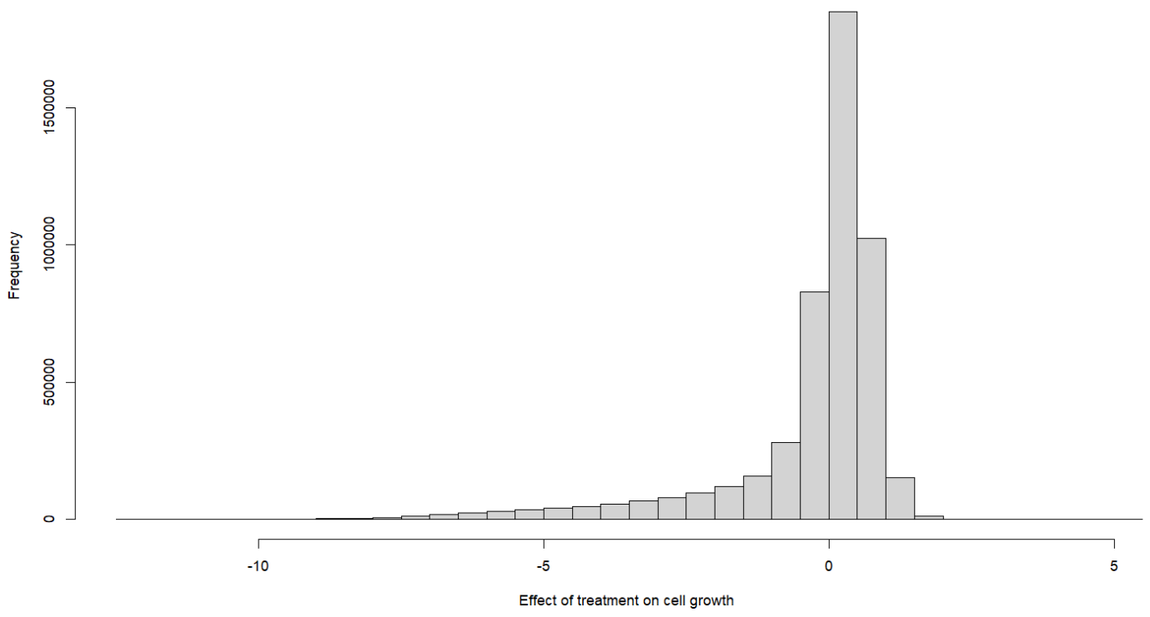
prism
 | treatment
Cell lines | Effect of treatment on cell growth
Notes:
A
24-base-pair DNA barcodes encoded within lentiviruses are stably integrated into individual tumor cell lines after blasticidin selection,
barcoded cell lines are individually frozen and later thawed to
generate mixtures of equal numbers of barcoded cell lines, which are frozen again.
Thawed mixtures are plated and then rearrayed into tissue culture assay plates.
Mixtures are treated with test compounds or vehicle (DMSO) controls.
At assay conclusion, genomic DNA is harvested from the mixture of remaining viable cells.
Barcode sequences are amplified using PCR and universal primers (one of which is biotinylated), and
amplified sequences are hybridized to individual microbeads harboring antisense barcode sequences and then to streptavidin-phycoerythrin.
A Luminex FlexMap detector quantitates fluorescence signal for each bead.
To adjust for differing barcoding efficiencies and differing cell doubling, the signal for each barcoded cell line is scaled to that of vehicle-treated control, thus demonstrating relative inhibition profiles for specific test compounds across multiple cell lines in mixture.

Slide 7
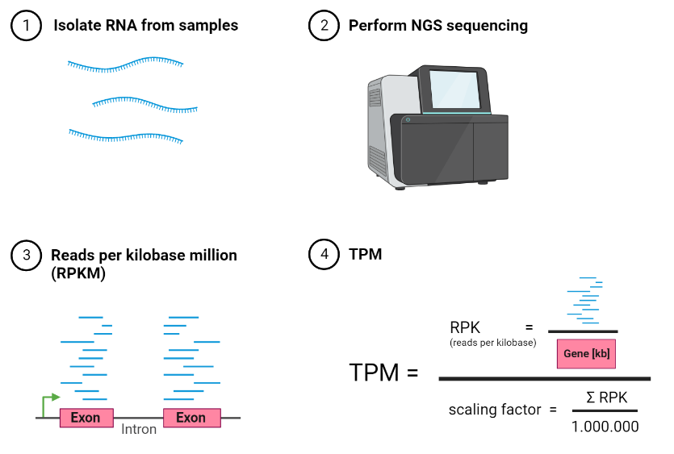
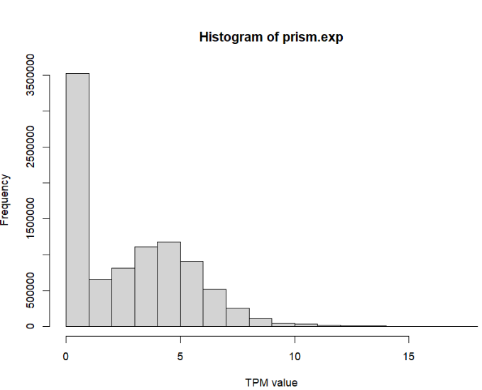
prism.exp
 | genes
Cell lines | Transcripts per million
ⓘ
Notes:
J
Range [1] 0.00000 17.25397
reflect level of gene expression,
higher values → over expression of genes
RNA-seq
→RPKM (reads per kilobase million)
$RPK \left(reads per kilobase\right)=\frac{read counts}{ length of gene [kb]}$ normalize for length
$scaling factor=\frac{\sum{RPK in sample}}{1.000.000}$ normalize for sequencing depth
$TPM=\frac{RPK}{scaling factor}$

Slide 8
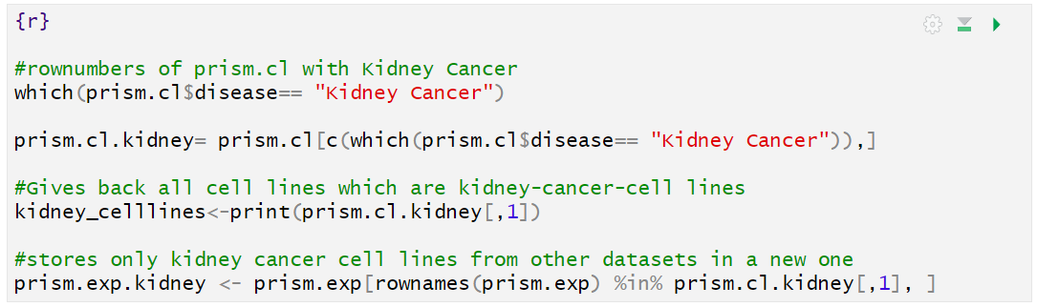
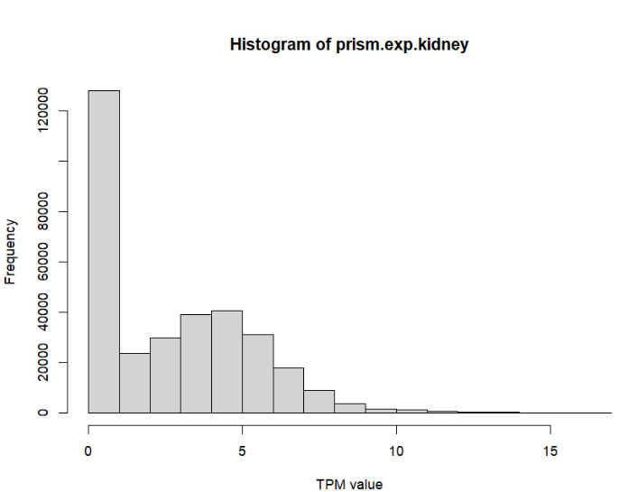
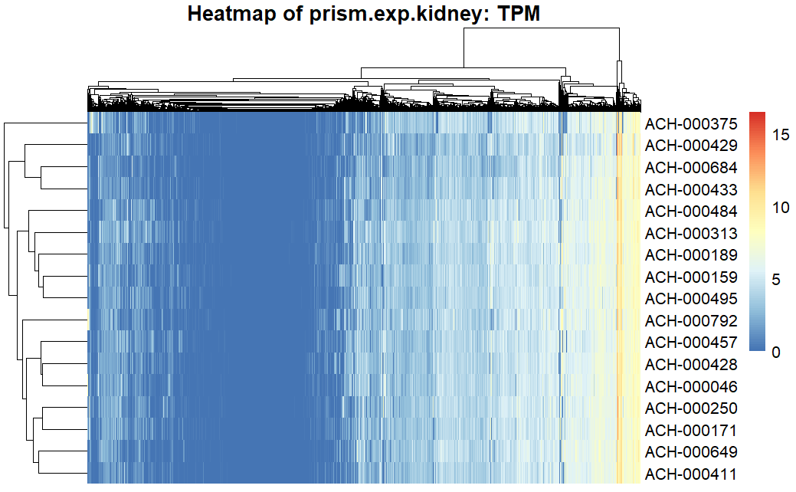
prism.exp.kidney
ⓘ
 | genes
Kidney Cell lines | Transcripts per million
Notes:
J
Range [1] 0.00000 16.48586

Slide 9
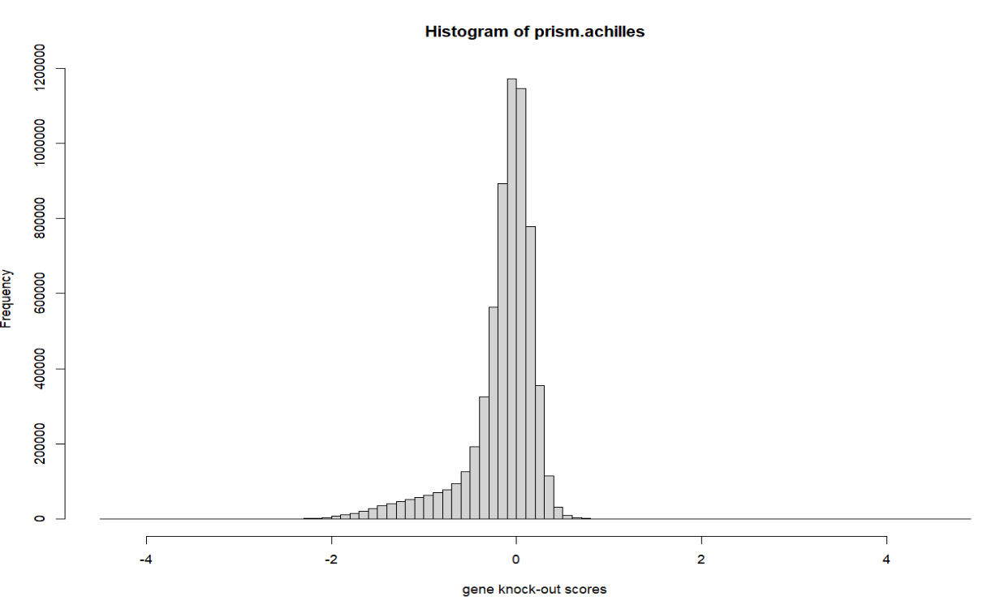
prism.achilles
 | genes
Cell lines | Gene knockout-scores
RNAi or CRISPR/Cas9 libraries (lentiviral-based, pooled )
in genome-scaled loss-of-function (LOF) screening
Notes:
F
https://www.takarabio.com/learning-centers/gene-function/gene-editing/genome-wide-screening/crispr-library-screening

Slide 10
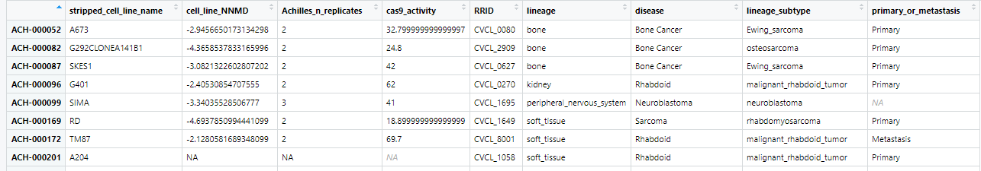
prism.cl
cell line information
Notes:
F

Slide 11

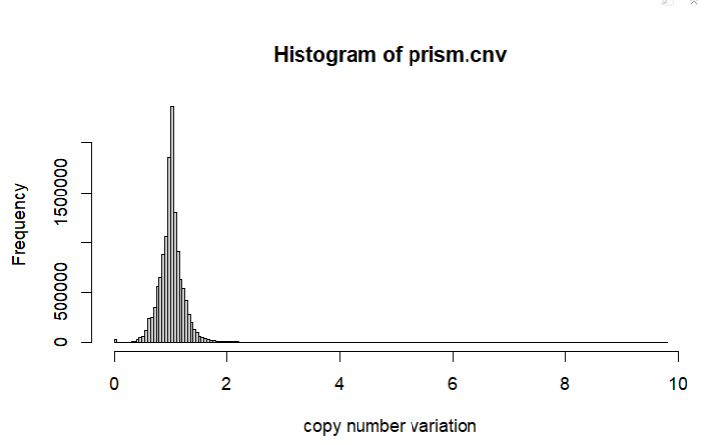
prism.cnv
 | genes
Cell lines | Copy number variation
Notes:
F

Slide 12
Steps and to-do‘s
Data cleanup
Dealing missing values (Removing or Imputing)
Is there any loss of information if we condense prism to prism.drug.means? ✓
Yes it is
Re-ordering rows/columns in meaningful and useful ways ✓
Data exploration
basic exploratory data analysis (distribution of the overall data, specific samples or features) ✓
Visualize the data distribution ✓
Is there a mode of action which is more represented?
Visualize the inter-dependencies among specific samples/features of interest
Correlation between gene expression & copy number & treatment effect
Check some of your hypothesis like - is something high/low between two conditions etc
Identification of thresholds
Identification of housekeeping /tumor supressor genes
Notes:
J,F

Slide 13
Steps and to-do‘s
Data reduction
Try out methods to reduce the dimensionality of this data
Cluster your samples to identify similar and dis-similar groups
Check how well the groups separate based on the features of your interesting
Data modelling
Try possible predictions
Check how the good the predictions are
Notes:
J,F

Slide 14
Milestones and timetable
Is there any loss of information, if we condense prism to prism.drug.means?
Identification of thresholds
Is there a mode of action which is more represented?
Correlation between gene expression & copy number & treatment effect
May June July
Notes:
J

Slide 15
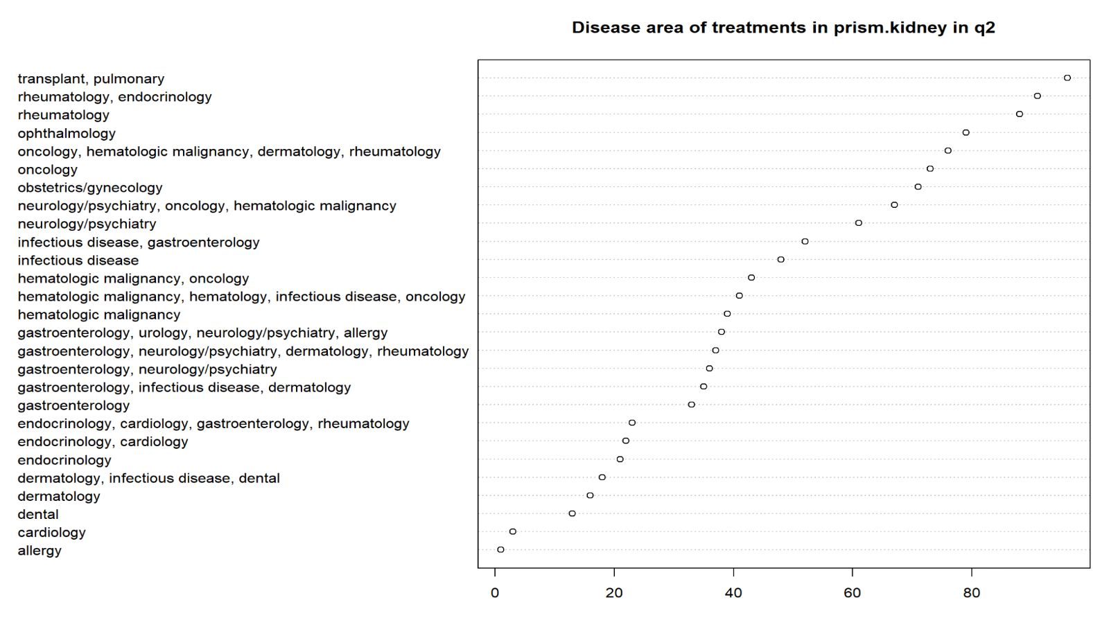
First results
Notes:
A

Slide 16
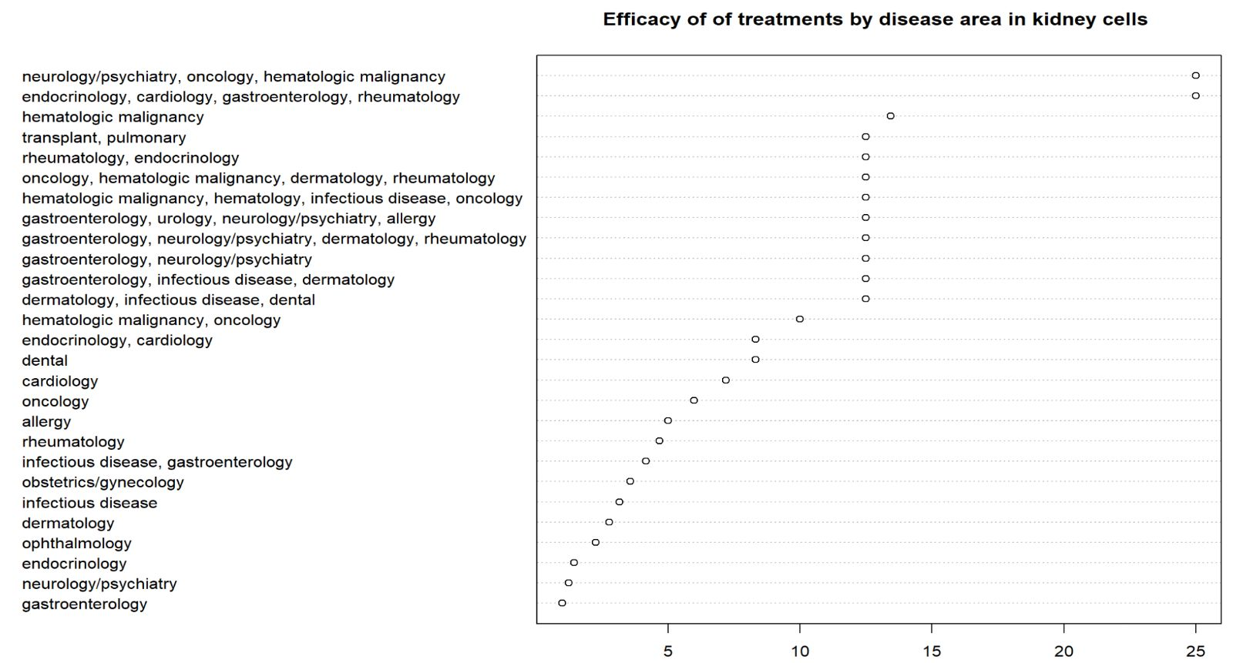
First results
%
Notes:
A

Slide 17
Thank you!

